Slide 1
How To Assemble Wheelchair Swing
Slideshow instructions and links to videos

Slide 2
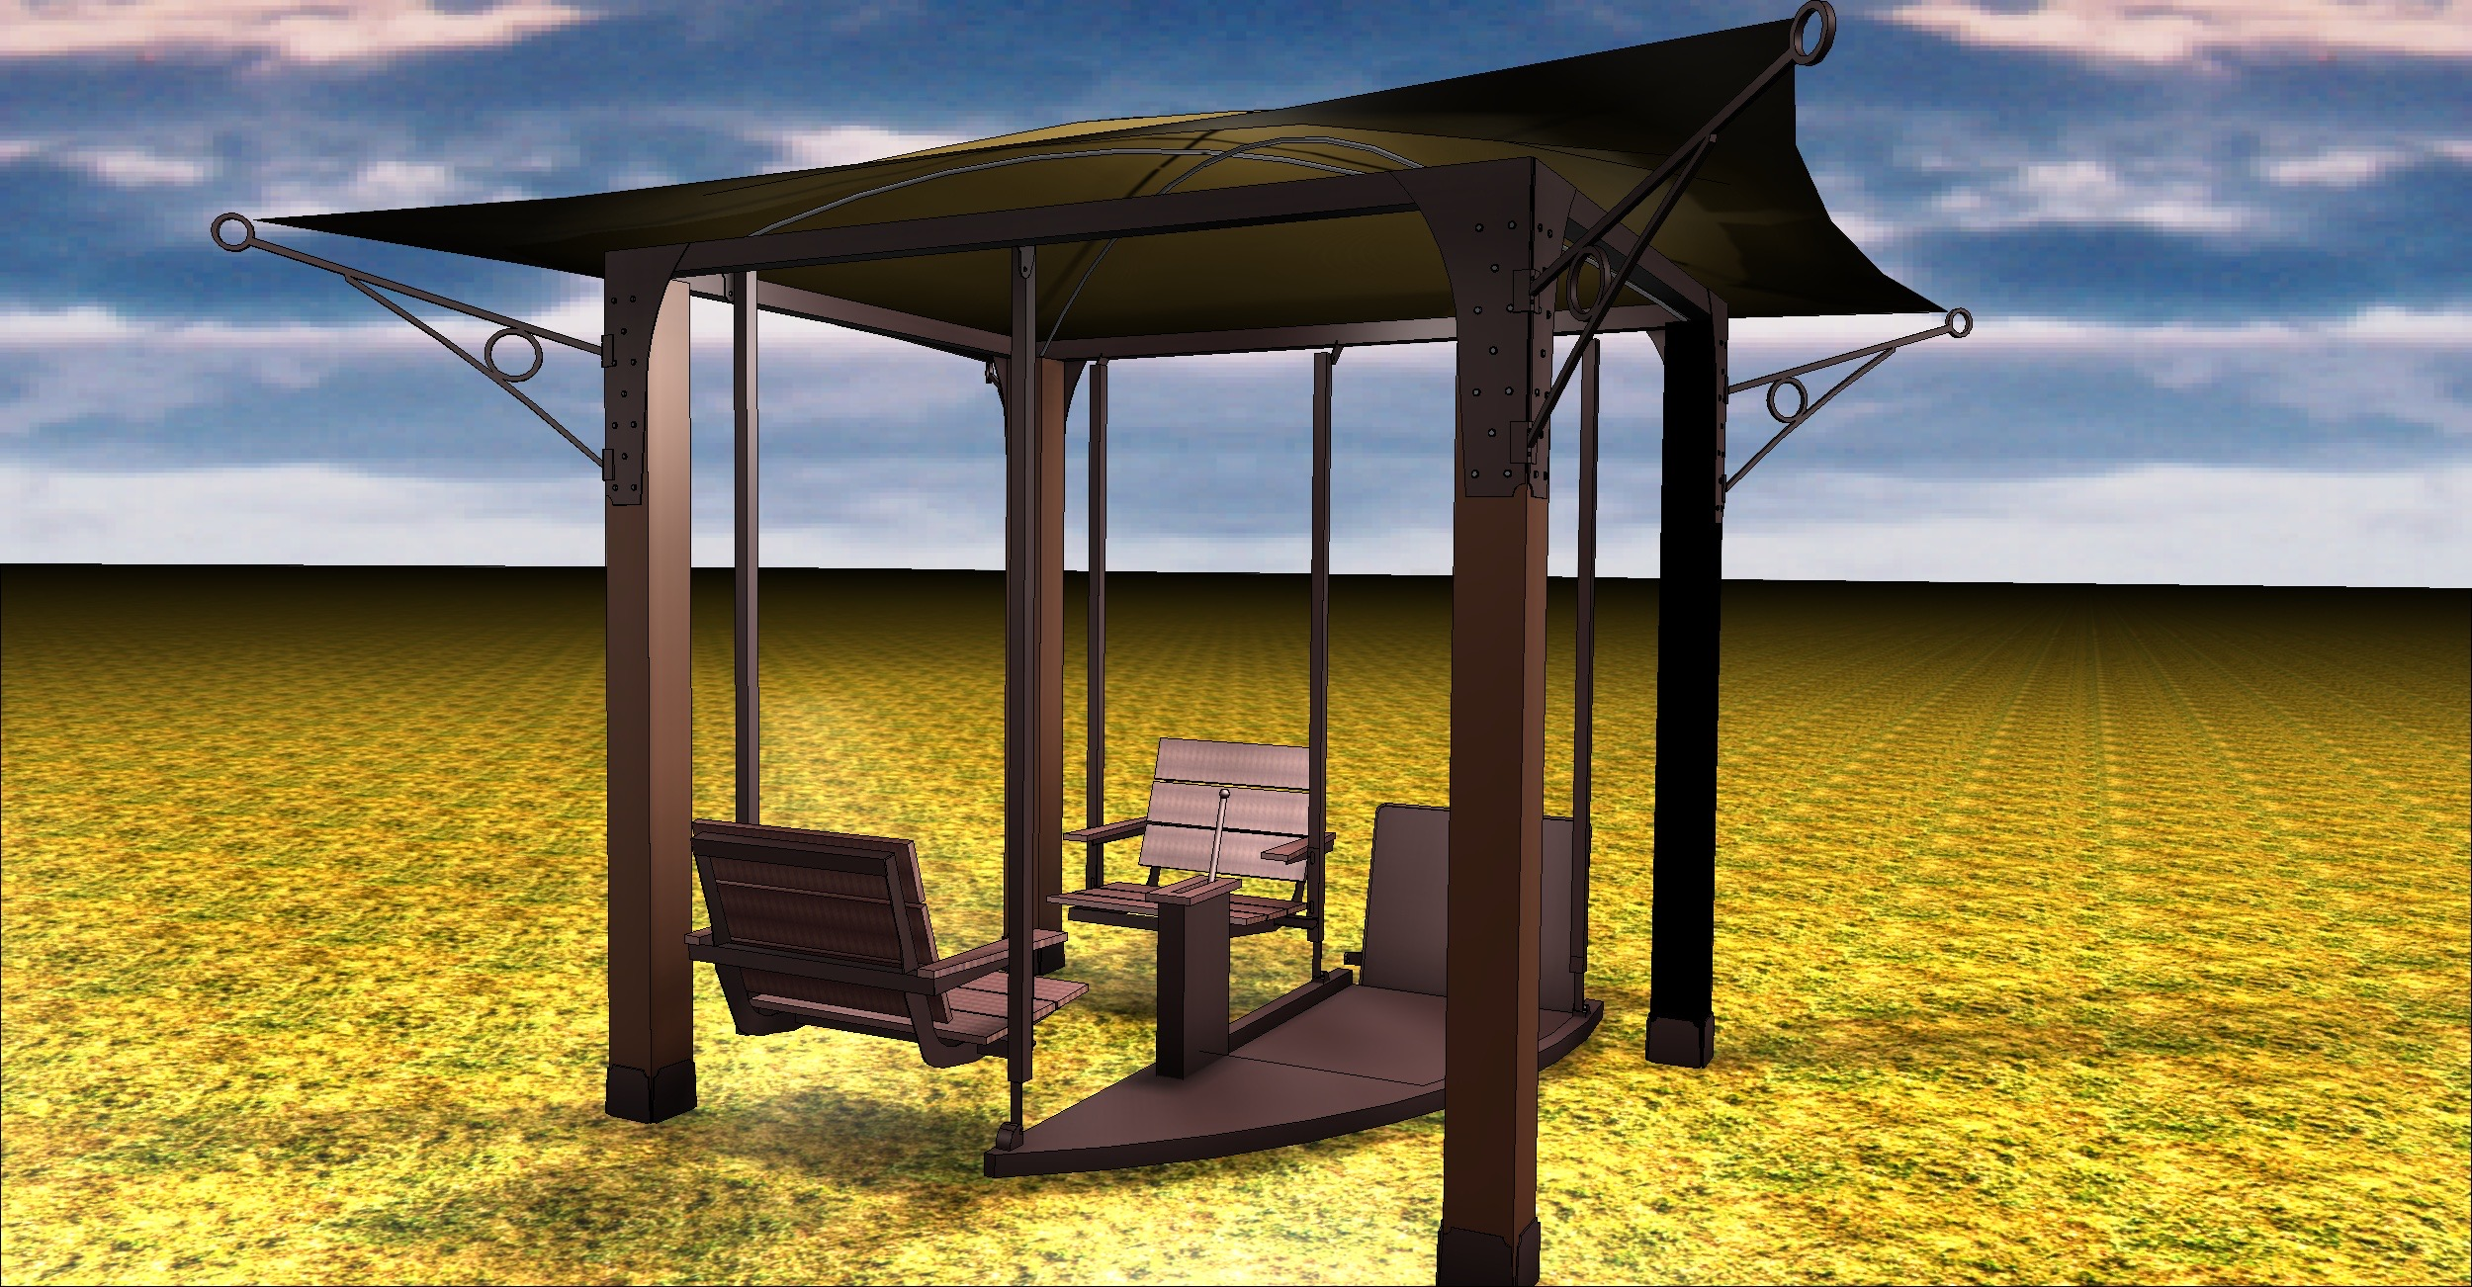
Plan your layout carefully!
Watching these videos will help you visualize your goal for the day:

Slide 3
It is HIGHLY recommended you watch these videos by following these links:
(May show a different model, but very helpful!)
https://youtu.be/Wu18pUDZnnU
https://youtu.be/9B_1VxEC5SU
https://youtu.be/nQrLpnhNyI8
Also be careful of sharp edges and staples etc.
while putting the swing together.

Slide 4
Tools needed:
Tape measure
Roto hammer for anchors
Impact driver for screws and drill
Large square
Set of wrenches
Level

Slide 5
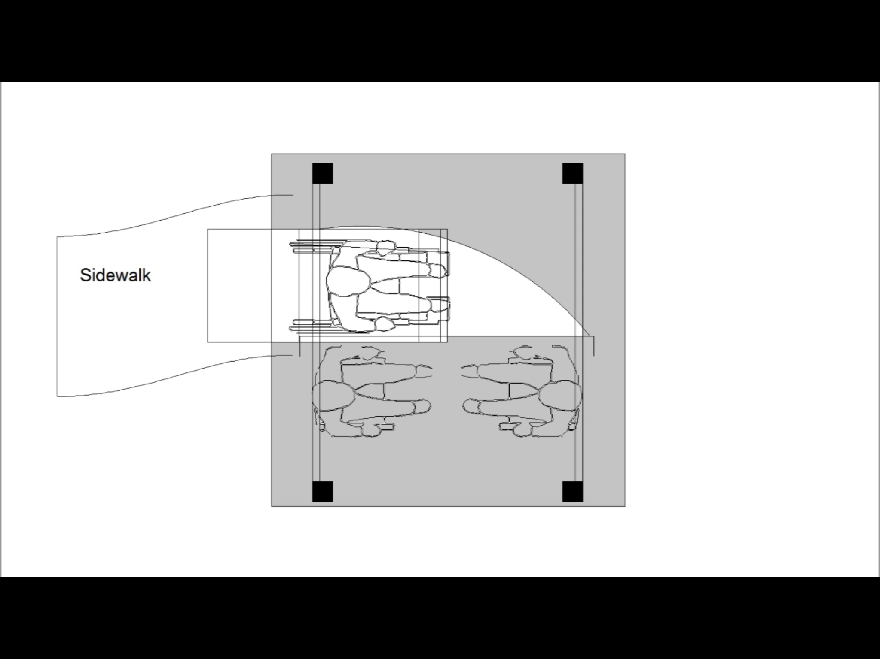
Consider where the wheelchair will approach!

Slide 6
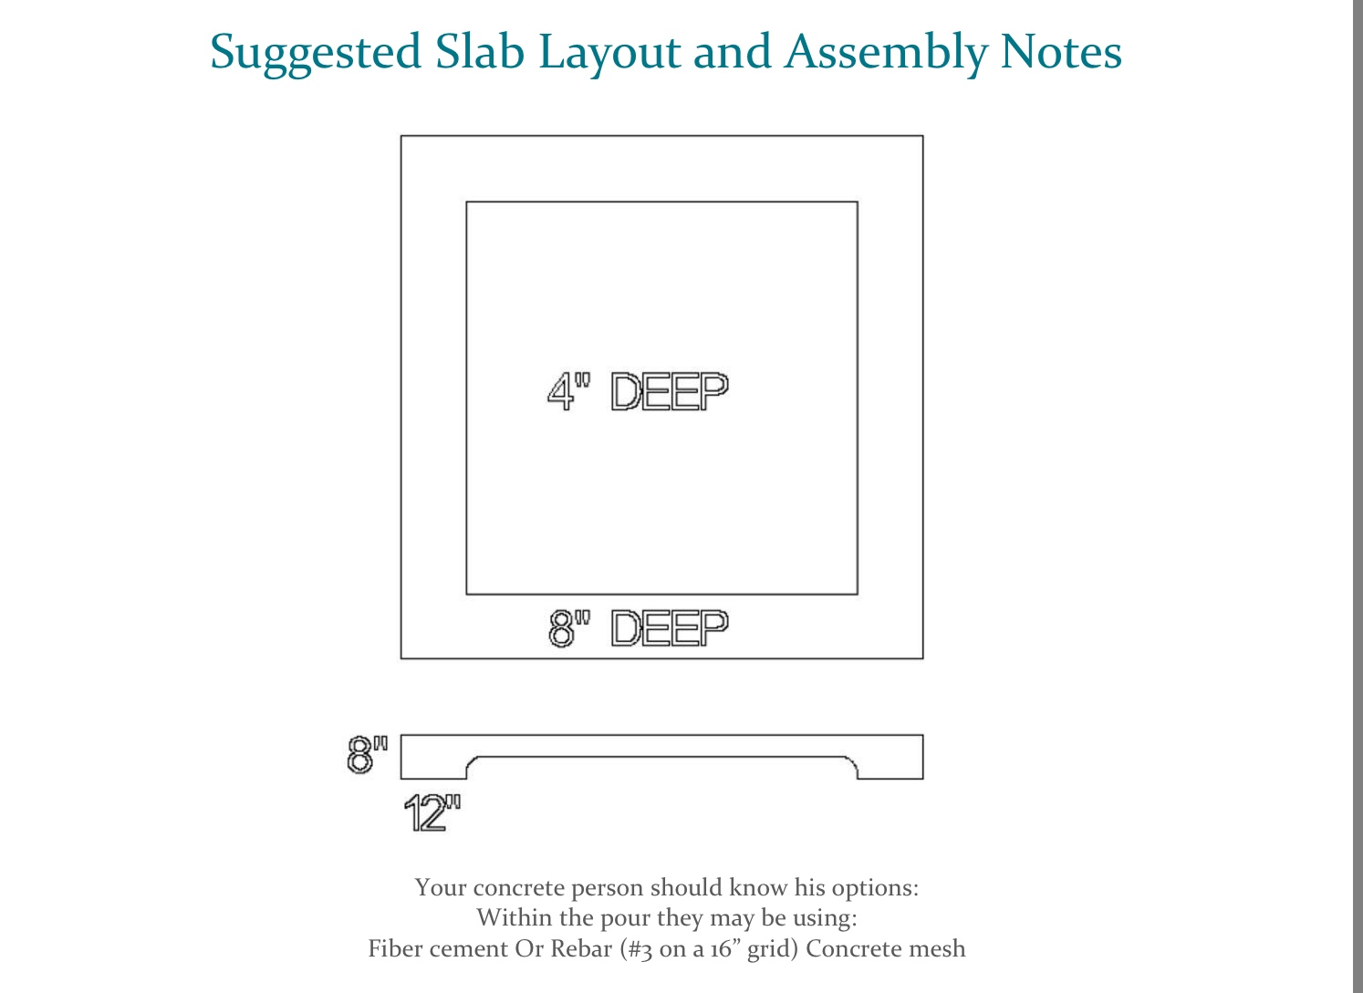
An 8’ x 8’ floating slab works great!

Slide 7
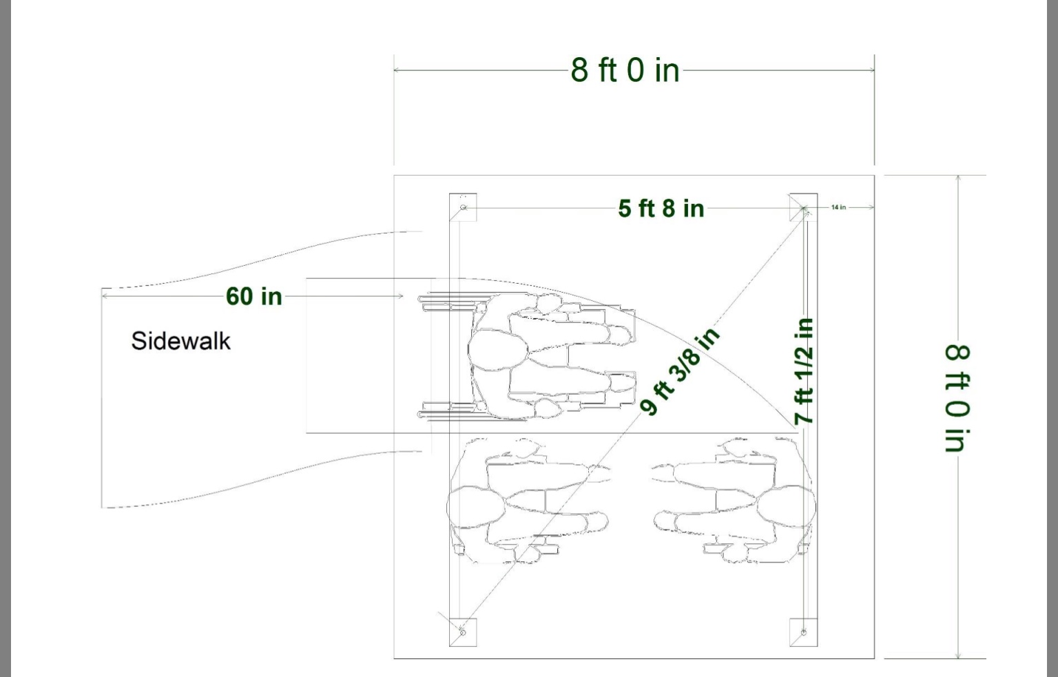
Set the anchor bolts first.
According to these measurements.

Slide 8
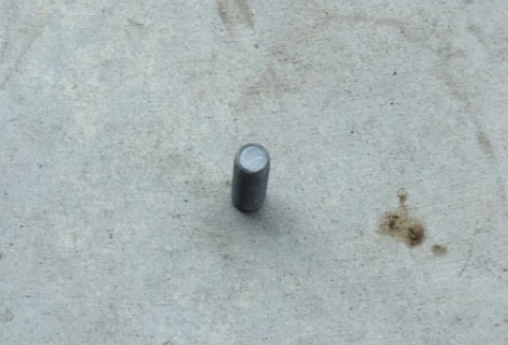
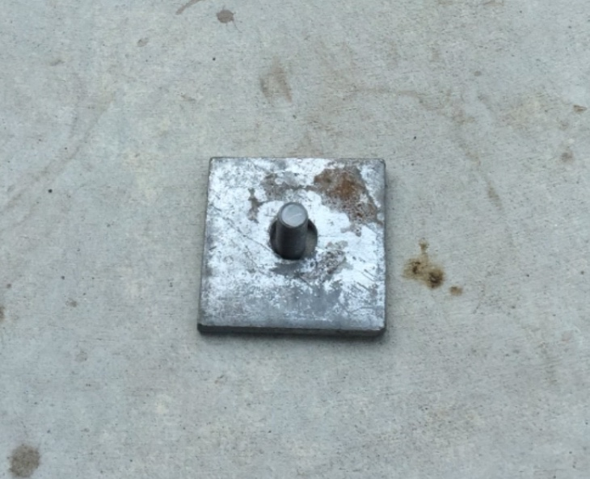
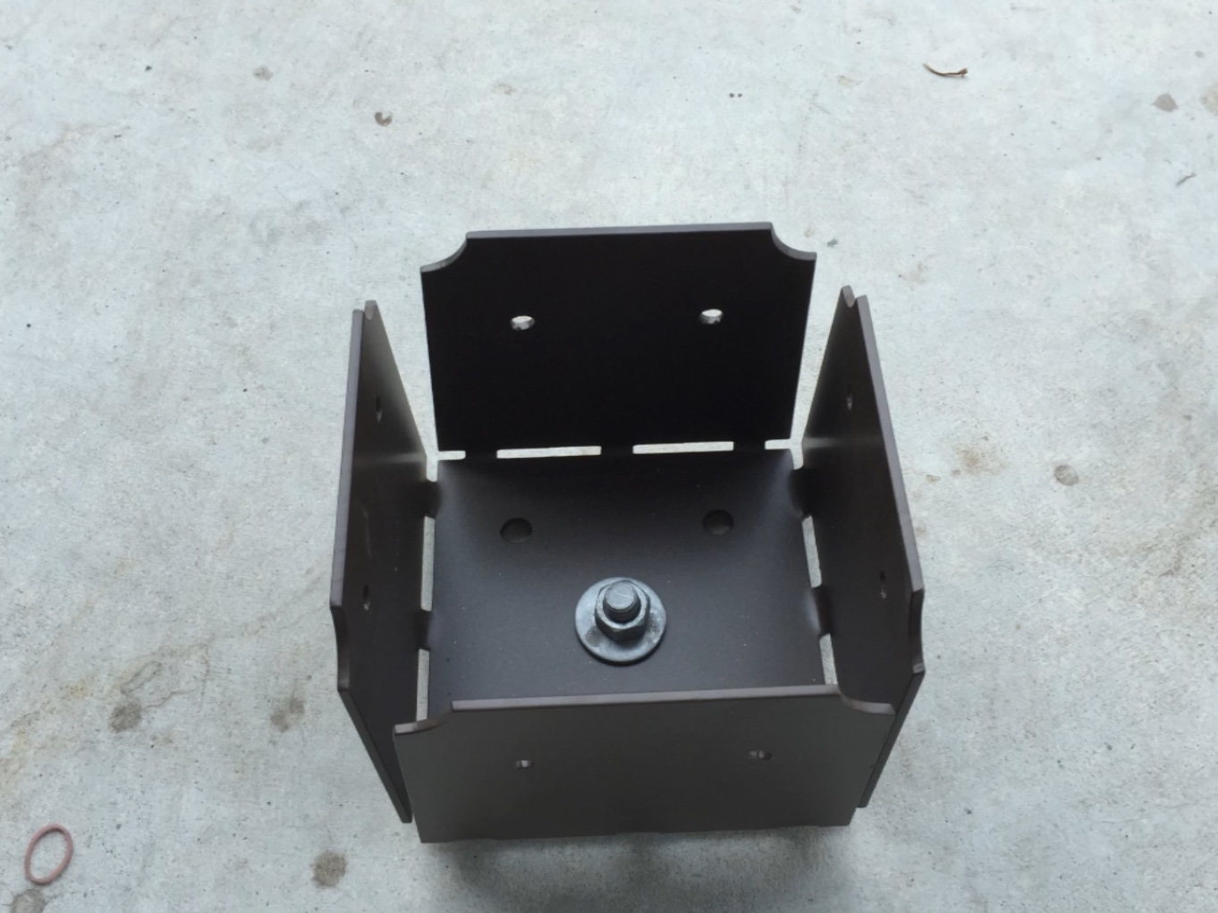
Galvanized plate goes UNDER the boot
That keeps things from moisture buildup

Slide 9
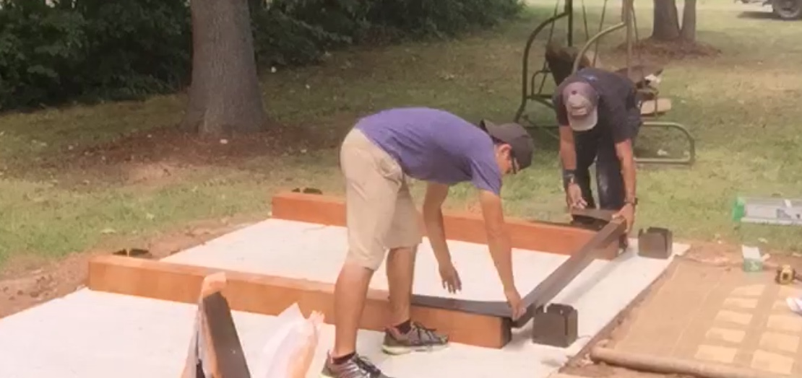
Layout two posts and attach the ‘short’ crossbar,
The sides of the crossbar flanges should sit about 1/4” from the outside edge of the wood.

Slide 10
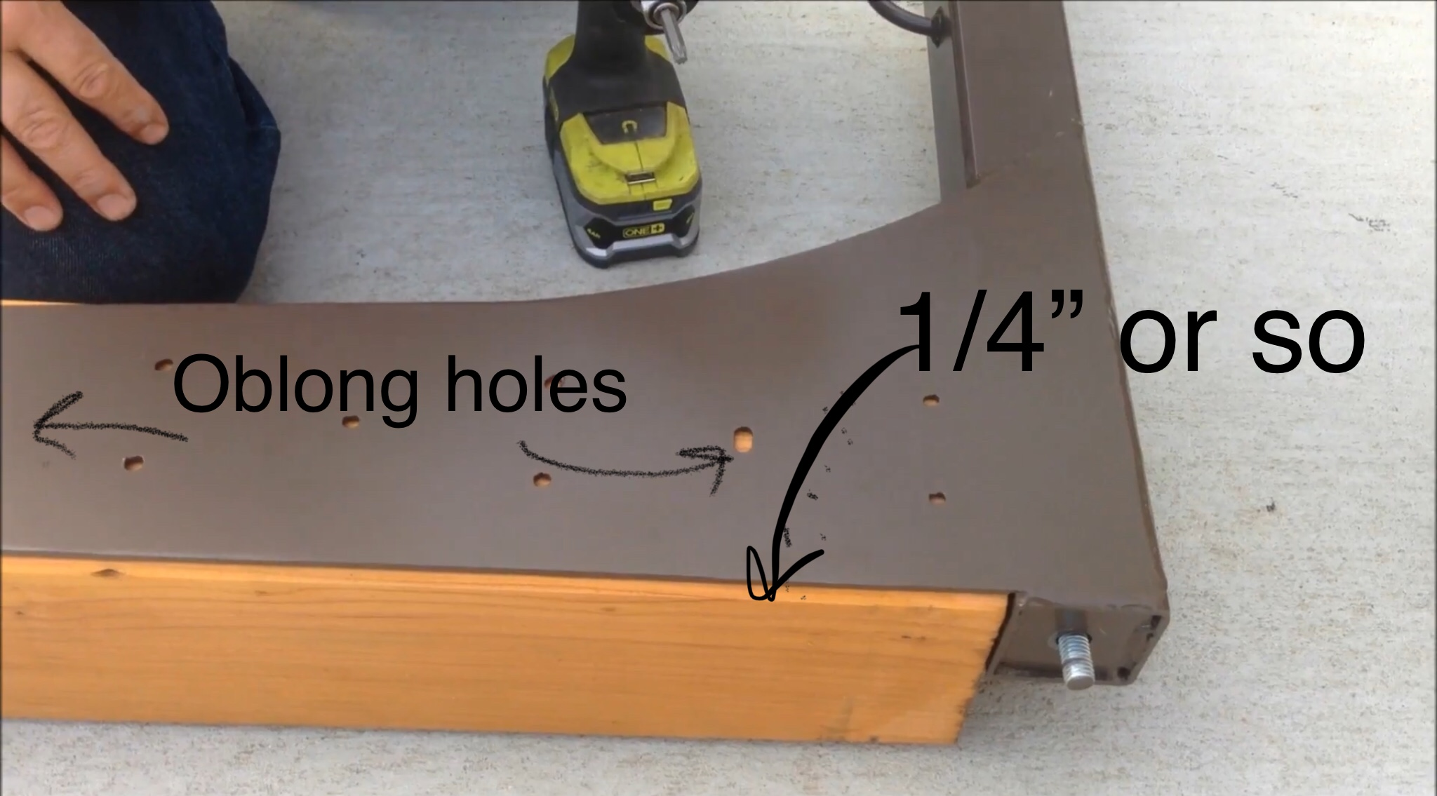
Screw only the oblong holes,
that way you can adjust for level
...after you stand everything up.

Slide 11
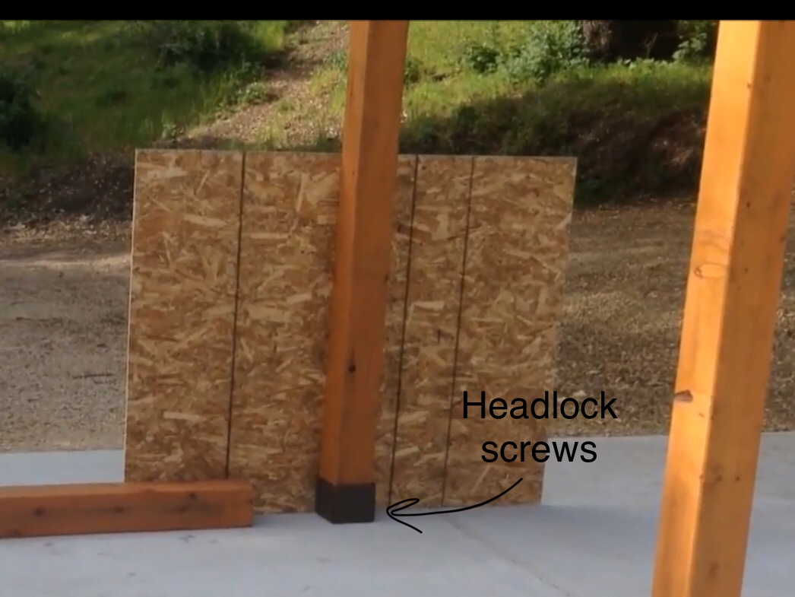
You can stabilize the piece using plywood,
while you are putting the next piece up.
I use the lid from the crate
and a couple of the sheetrock screws.
Place the 4 HeadLock screws into each post base.

Slide 12
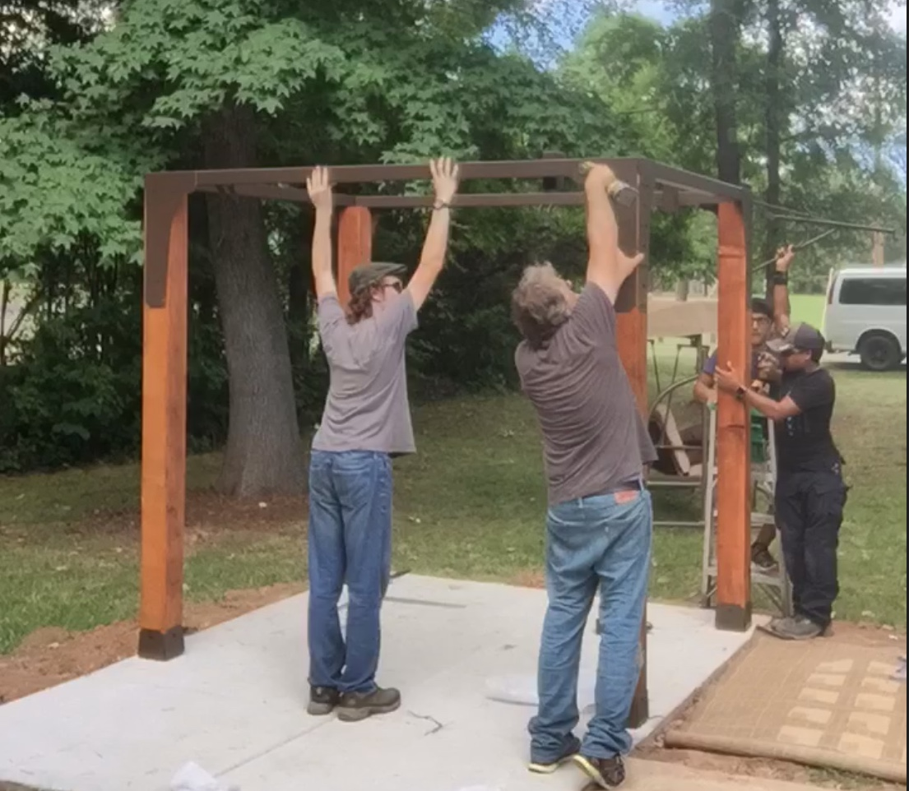
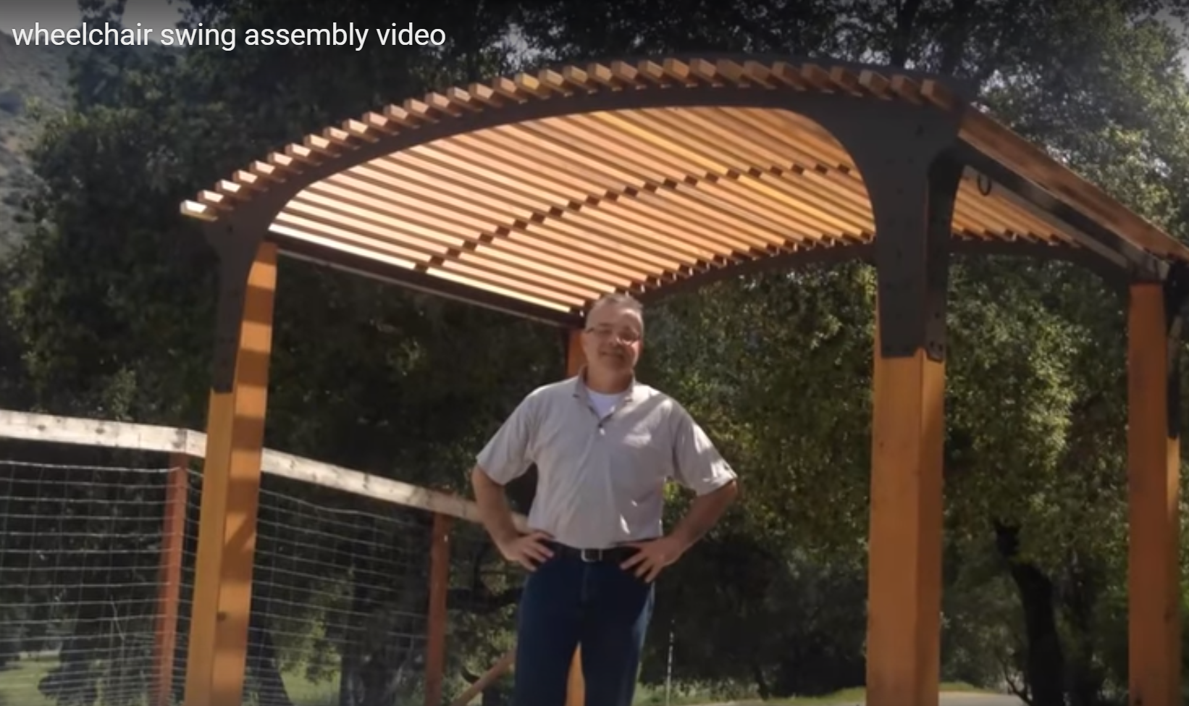
Canopy model continue below: Pergola model please watch video:
OR
Mount the long crossbars,
keeping in mind that the side with 3 swingarm locations is the side the wheelchair ramp will be. Make sure everything is straight before you commit to putting in all the headlocks in.
https://www.youtube.com/watch?v=Wu18pUDZnnU&feature=youtu.be

Slide 13
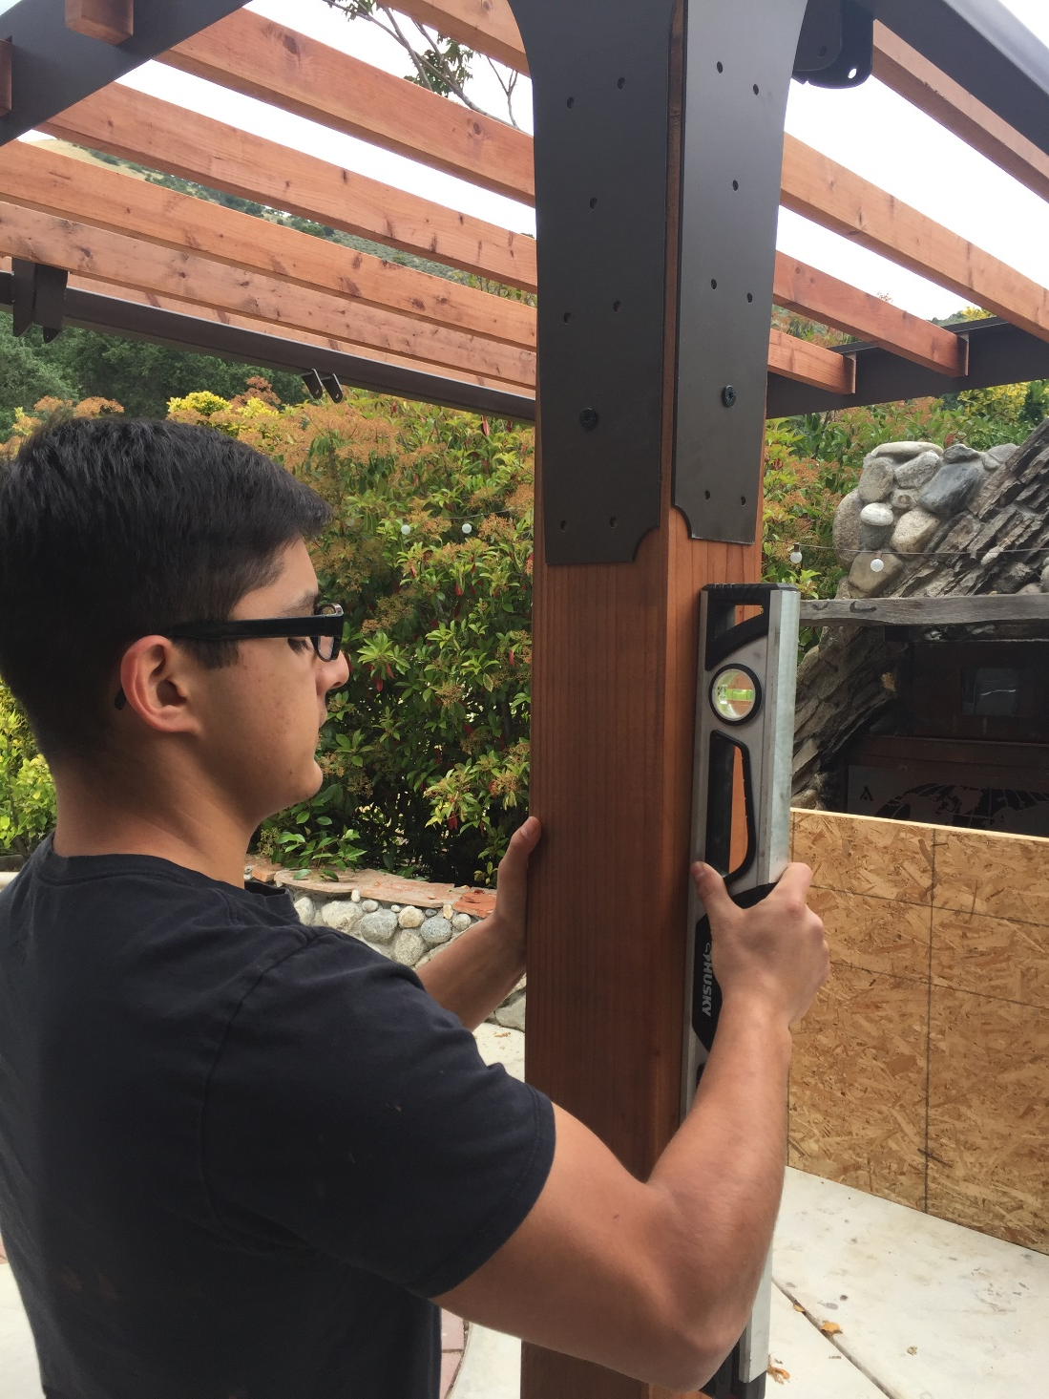
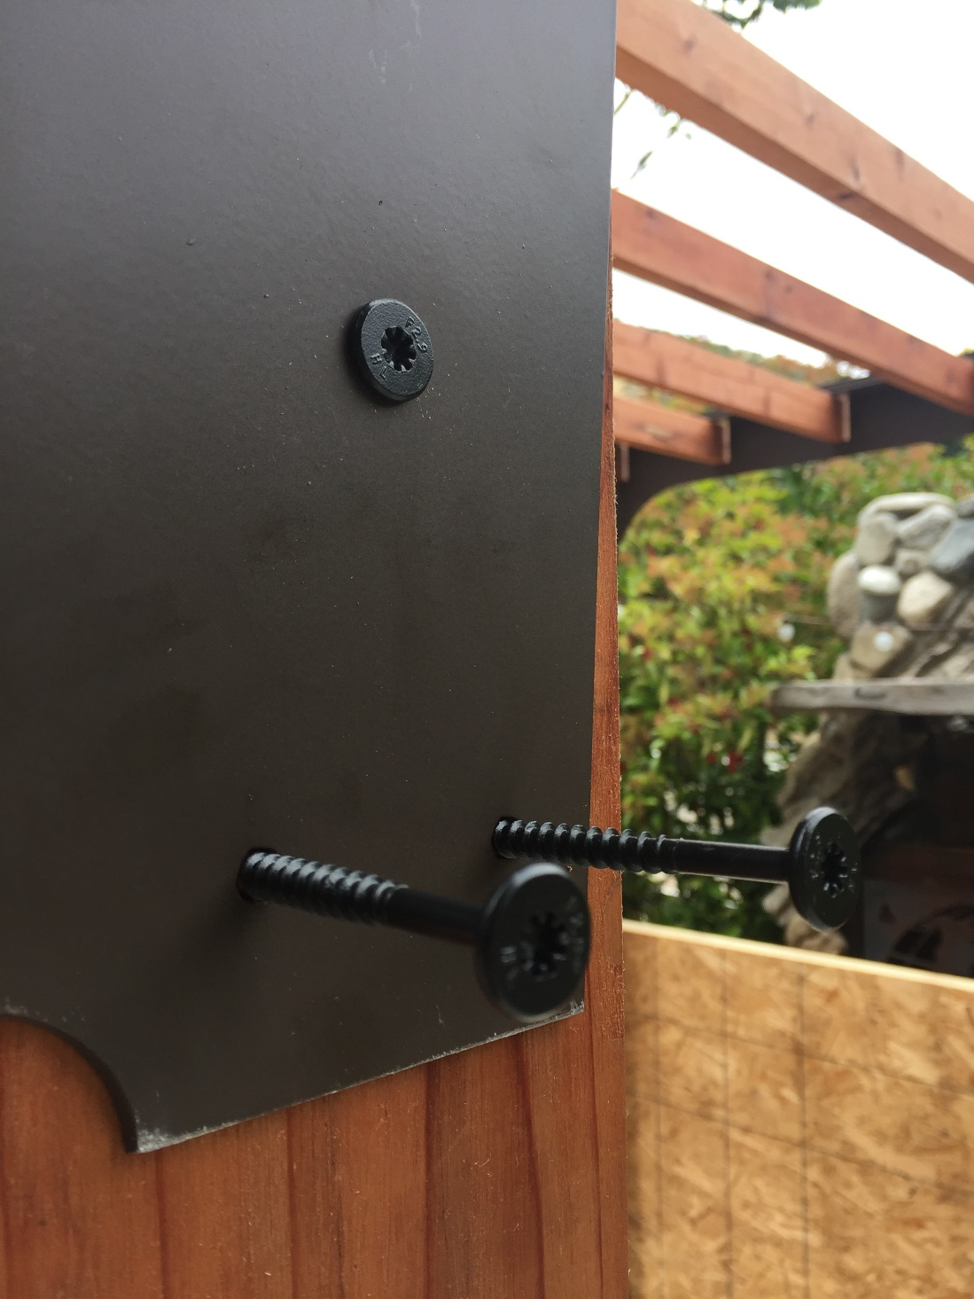
Make sure posts are level
before you commit to all the screws

Slide 14
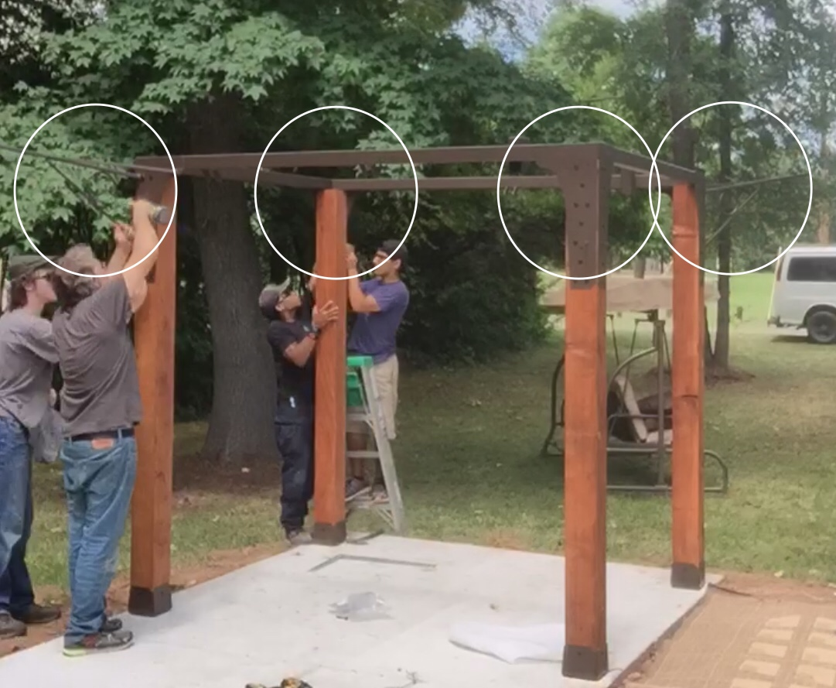
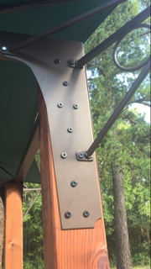
Check posts for level, then mount the canopy arms,
using two of the headlock holes, and one hole that uses a small 1/4” nut and bolt.
Now you can put in the rest of the headlocks.
Be CAREFUL not to over tighten (redwood is soft).

Slide 15
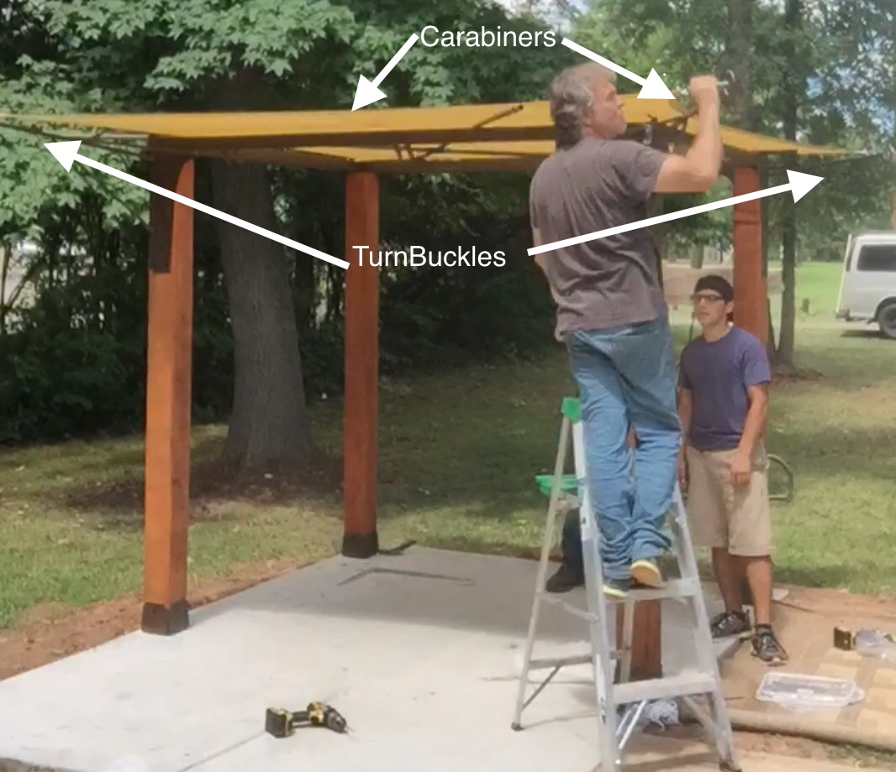
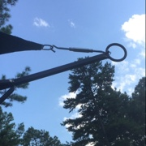
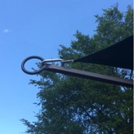
Hook the canopy up,
keep the turnbuckles extended
and don’t tighten them
until you place the PVC pipe on the studs.

Slide 16
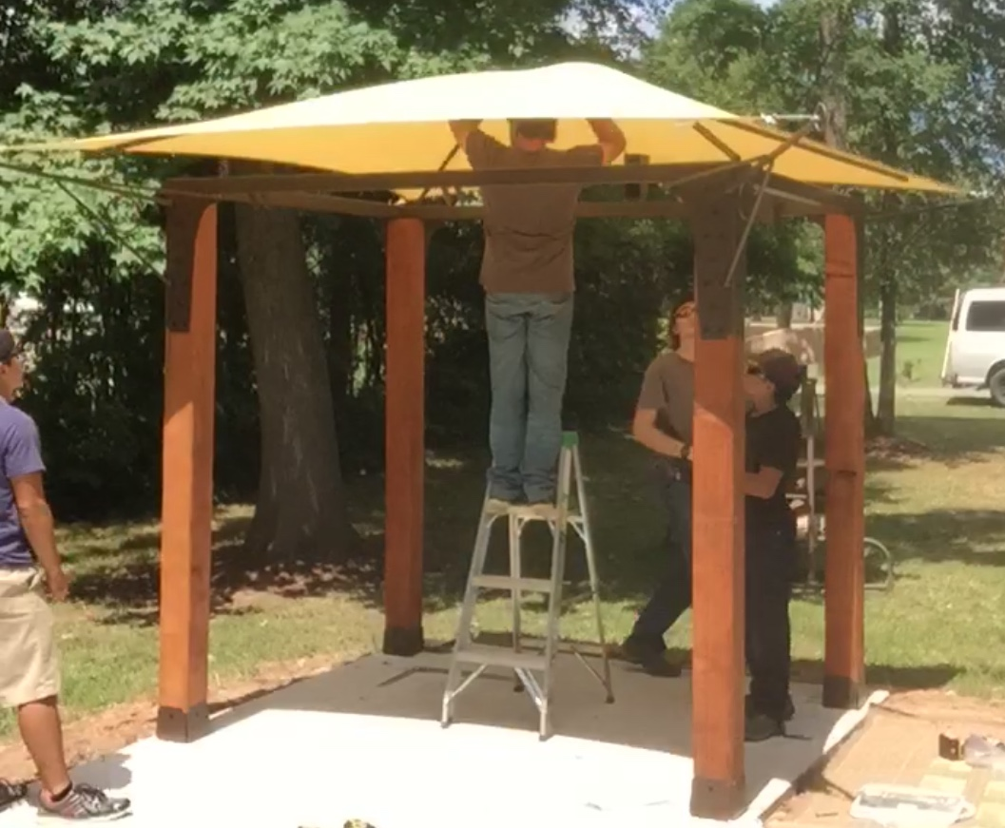
Put PVC tubes in center cross fitting, stretch the canopy upwards, and have another person insert outside ends over the studs that are welded onto canopy arms.
The canvas stretches pretty tight.
You will need muscles and a ladder!

Slide 17
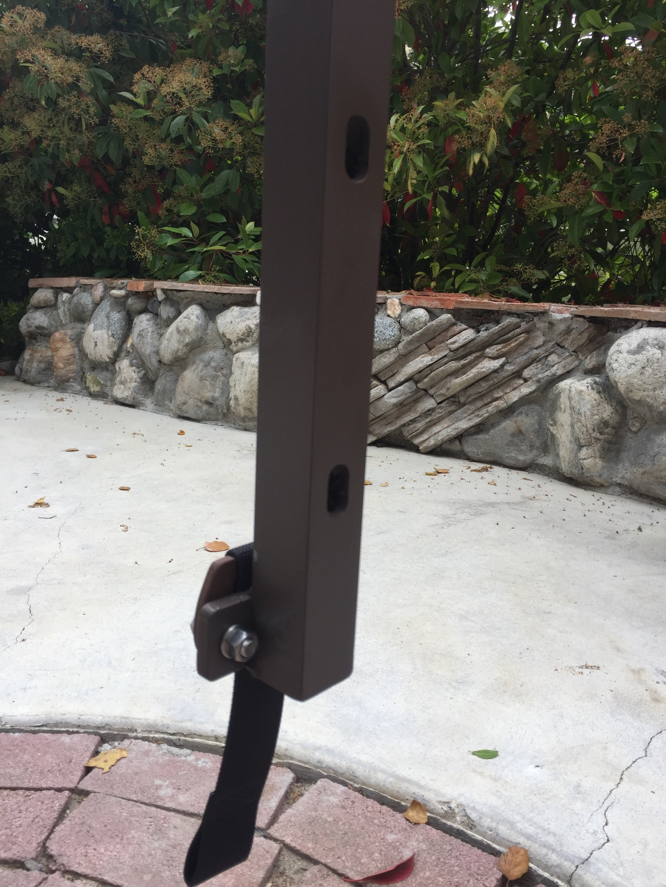
Hang the Swing Arms

Slide 18
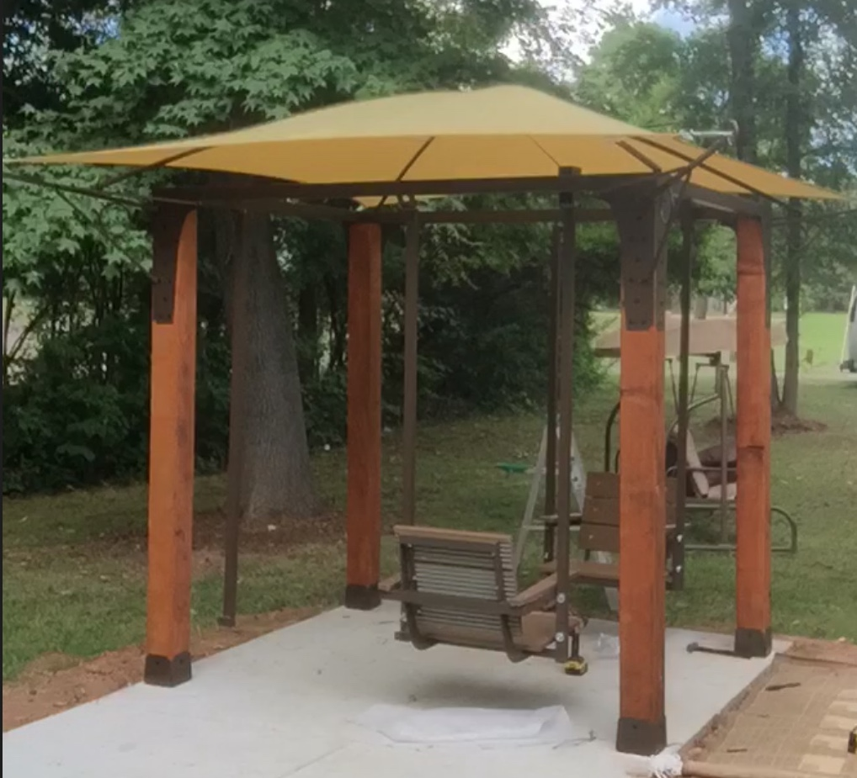
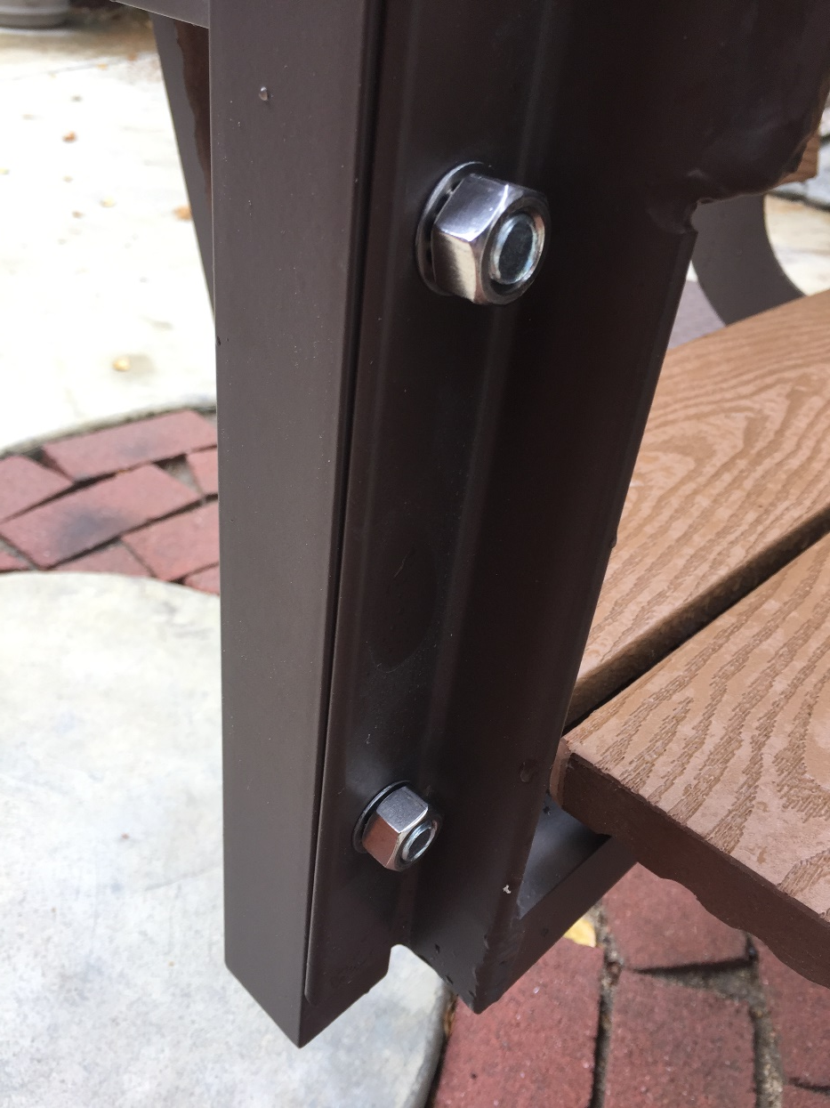
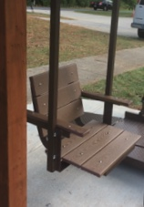
Mount the chairs using the large carriage bolts

Slide 19
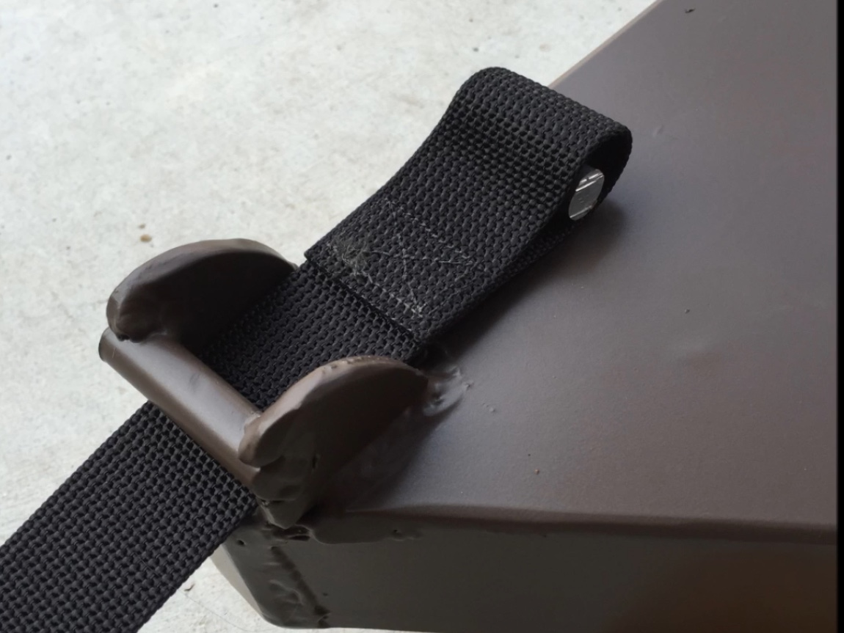
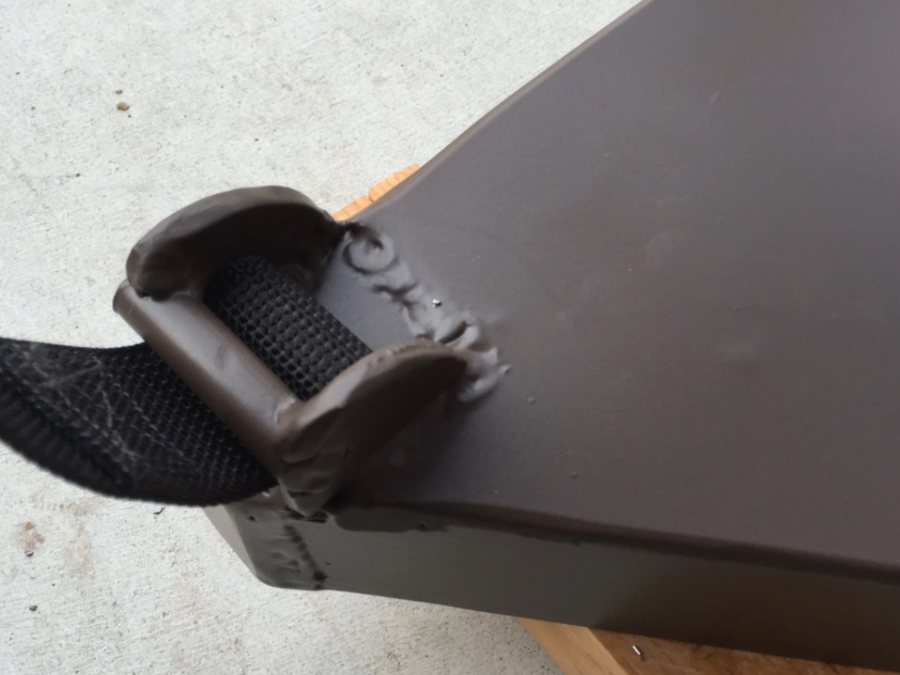
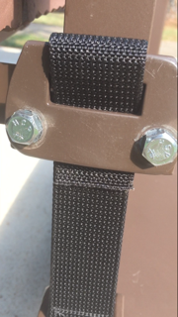
Hang the platform,
the straps are pressure fit with the aluminum pins.

Slide 20
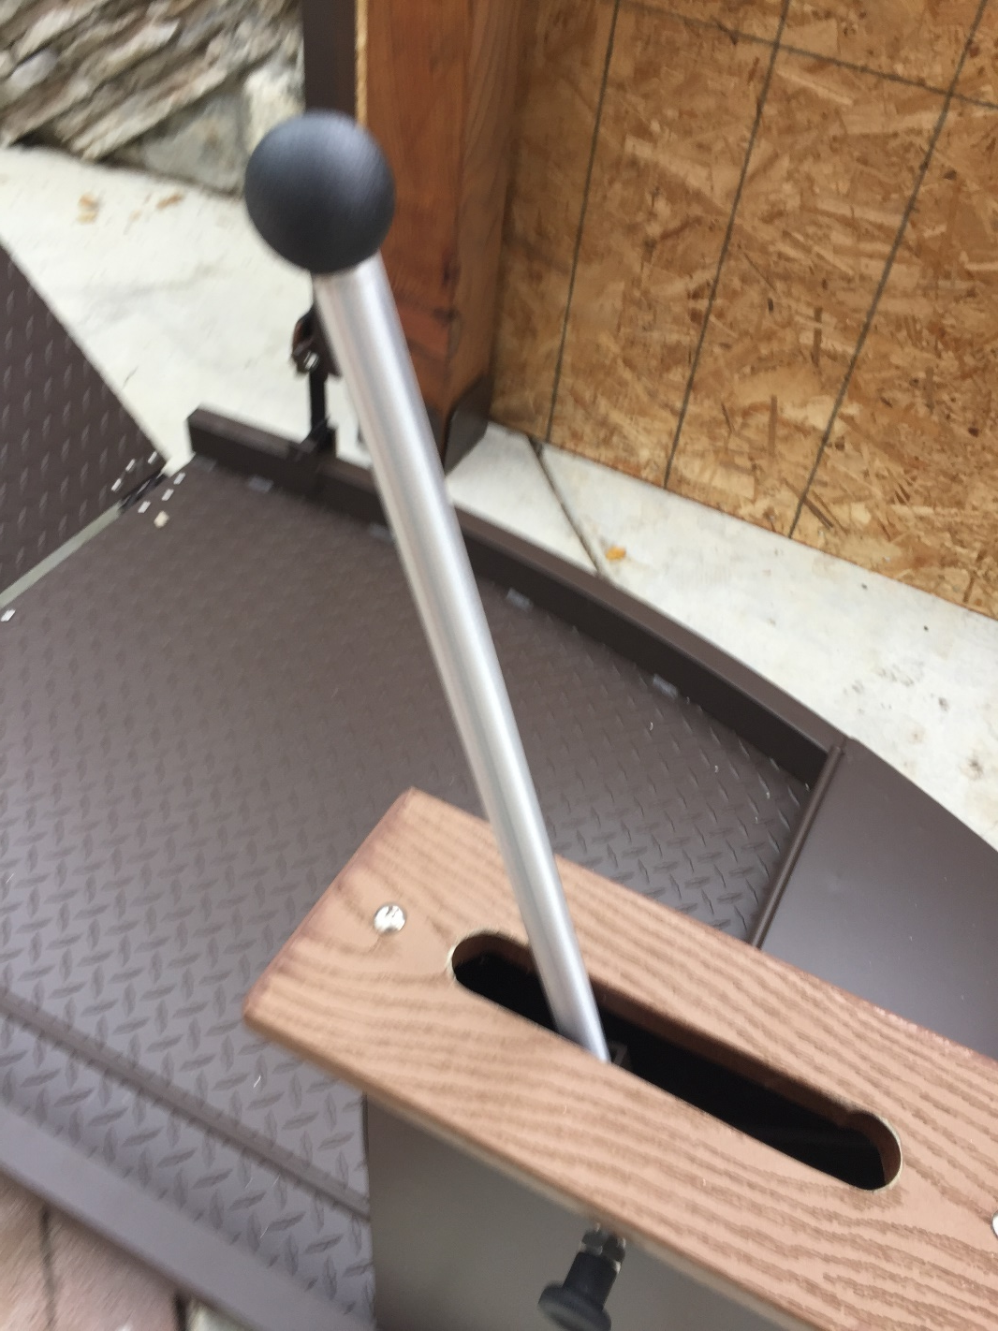
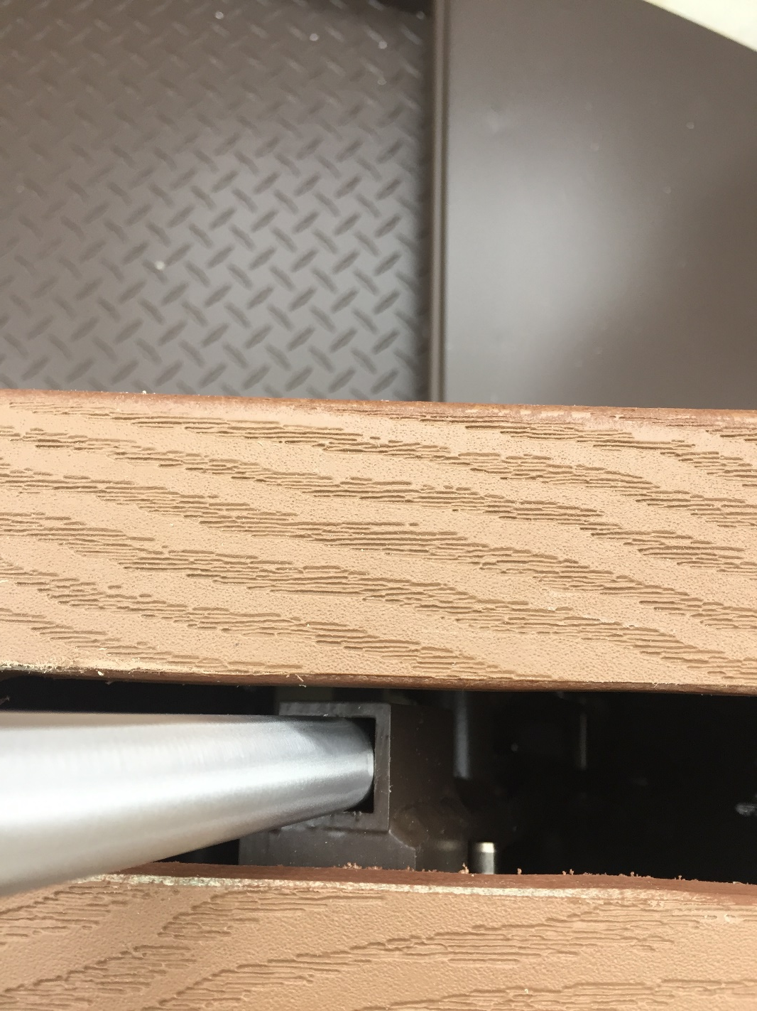
Insert the Aluminum Handle. Use a rubber mallet or piece of wood to
Tap it in until it fits pretty snug.
Then use ¼ threaded bolt to secure.

Slide 21
3” between platform and concrete
The brake stud should be BARELY touching the concrete when there is no wheelchair on the platform.

Slide 22
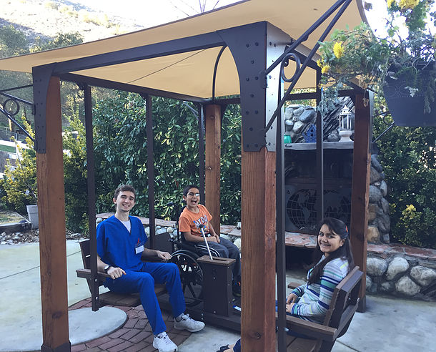
Make sure everything is fastened properly
before you try the swing!
Share instructions to EVERYONE on how to use the swing by texting the word SWING
to 805-219-6912

